Slide 1


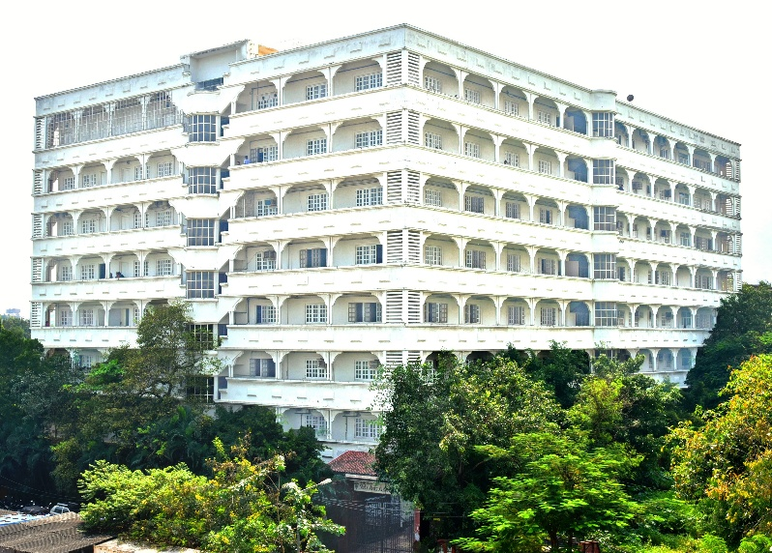
Mahavir Education Trust’s
Shah & Anchor Kutchhi Engineering College
Chembur, Mumbai-400088
(An Autonomous Institute Affiliated to University of Mumbai)
Department of Cyber Security
presentation
on
My Self-Learning Journey
(Subject:Advanced Digital Forensics HNCSCR0701 )
by
(Priya Gaglani 23UF18027CM016)
Email: priya.18027@sakec.ac.in

Slide 2
Vision & Mission
Institute Vision
Department Vision
To be a high repute focused department preparing students ethically in field of cyber security and make them capable to lead technical, economic, social and ethical development of the society.
To become a globally recognized institution offering quality education and enhancing professional standards
Institute Mission
Department Mission
To impart high quality technical education to the students by providing an excellent academic environment, well - equipped laboratories and training through motivated teachers.
1. To provide an academic environment for the development by providing training and skill development to build knowledge, skills, values, and confidence to take a leadership role in the field of Cyber Security.
2. To cultivate research and entrepreneurship culture resulting in knowledge and innovative technologies that contribute to sustainable development of the society.
3. To enhance academic and corporate collaborations.

Slide 3
Program Specific Outcomes
Index | Outcome
PSO1 | The Cyber Security graduates are able to gain a thorough understanding of the Cyber Security landscape with its growing threats and vulnerabilities in the world of computing including software and hardware.
PSO2 | The Cyber Security graduates are able to attain skills to comprehend and anticipate future challenges and devise methods to meet them and also, be articulate and skilled to convince all the stakeholders
PSO3 | The Cyber Security graduates are able to acquire and demonstrate the ability to use ethical standard tools, practices and technologies for the analysis, design, development, implementation and testing of innovative and optimal Cyber Security solutions without compromising the privacy needs of individual and entities and the security concerns of law enforcement agencies.

Slide 4
Outline
Introduction
Problem Statement & Objectives
Core Concept / Theory
Working / Mechanism
Functional & Non-Functional Requirements (if applicable)
Challenges / Limitations
Case Study / Example
Comparative Analysis (if applicable)
Tools & Modeling Approaches
Applications in Real Life
Proposed Framework / Design
Conclusion & Future Scope
Reference

Slide 5
My Self-Learning Journey
Purpose: to reflect on what I learned from two self-paced cybersecurity courses, how I worked through them, and where they fit in my plans.
Cisco Ethical Hacker
Cisco Networking Academy
The wide view: how an authorised security assessment is scoped, carried out and reported.
Certificate date: 16 Sep 2026
Kali Linux Advanced Wireless Penetration Testing
Infosys Springboard
The close-up: how the security of wireless networks is assessed.
Completed: September 2, 2026
complementary
Independent learning
Working through self-paced material on my own
Technical understanding
Connecting ideas across the two courses
Career development
Building a base for security-related roles

Slide 6
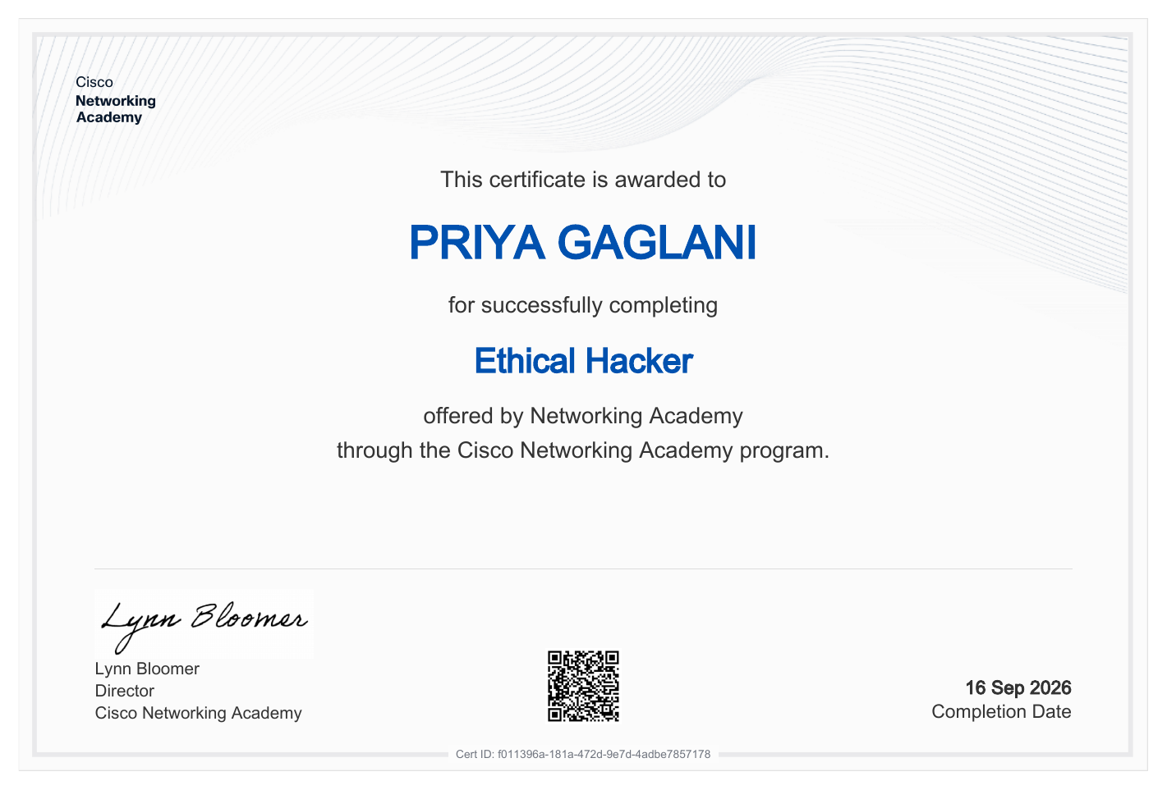
Activity 1: Cisco Ethical Hacker
Course snapshot
Provider: Cisco Networking Academy
Course: Ethical Hacker
Certificate date: 16 Sep 2026
Completion: Final assessment passed; badge awarded
1
Why it matters
Ethical hackers test systems with permission, so weaknesses are found and fixed before an attacker finds them.
2
How the course is built
Ten modules, starting with ethical hacking and penetration testing basics, then planning and scoping an assessment.
3
What I took from it
Cisco describes the course as scoping, executing and reporting. For me the useful part was seeing the whole assessment as a process, not a toolbox.

Slide 7
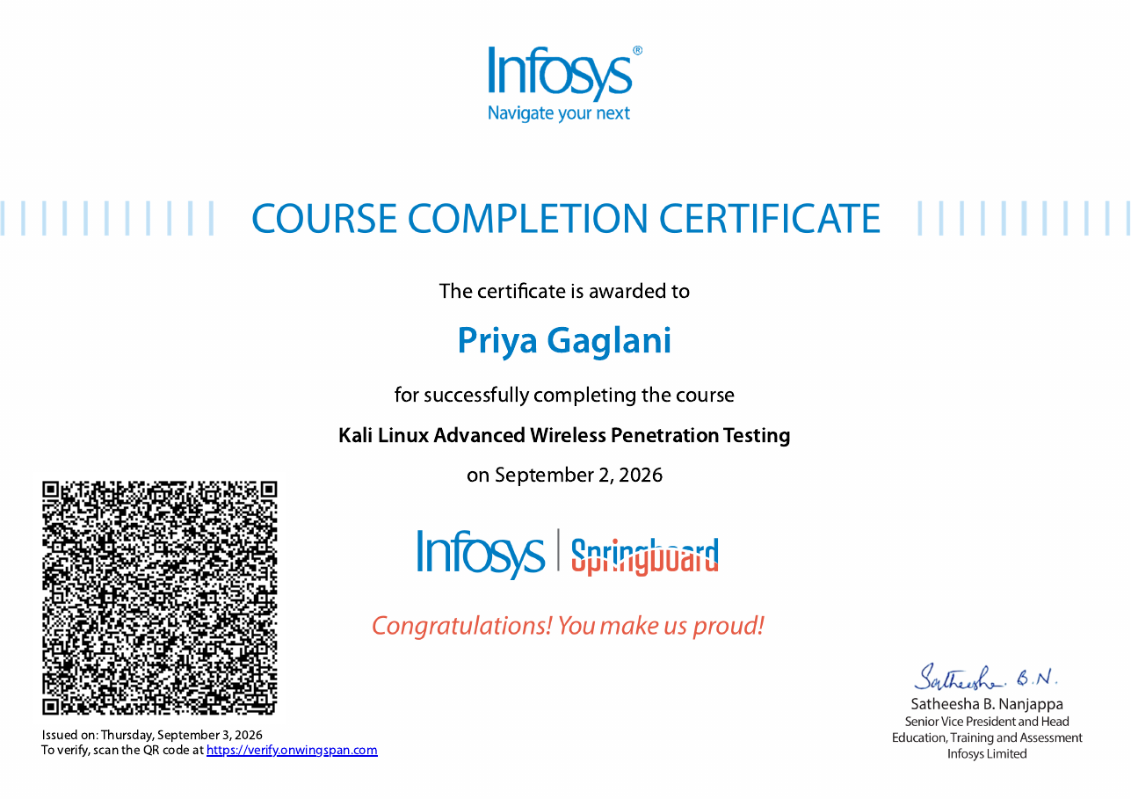
Activity 2: Wireless Penetration Testing
Course snapshot
Provider: Infosys Springboard
Course: Kali Linux Advanced Wireless Penetration Testing
Completed: September 2, 2026 (issued Sep 3, 2026)
Verification: QR code on the certificate
Ethical hacking (Cisco)
the whole assessment process: scope, assess, report
Wireless security (Infosys)
one area looked at in depth: Wi-Fi networks and how they are protected
How I see the link
Wireless networks are how most devices connect, so they are a natural area to assess.
Kali Linux is a Linux distribution that bundles security tools; the course uses it as its setting.
I claim the course and the concepts, not lab experience. Hands-on practice is a next step.

Slide 8
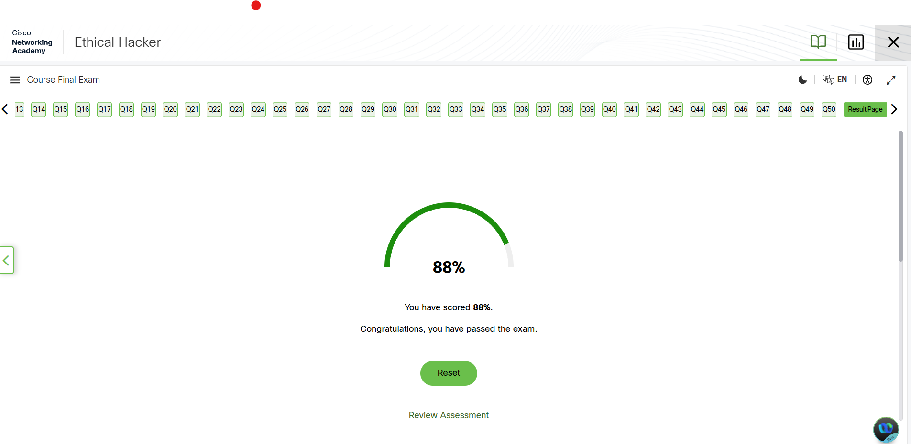
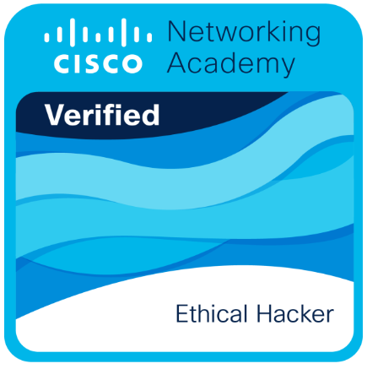
Learning Process and Evidence
1 Study
2 Flag
3 Revisit
4 Check
Work through the course material module by module
Mark terms and ideas I do not recognise
Return to harder topics and re-explain them simply
Use the assessments to test what I actually understood
Resources: the Cisco Networking Academy and Infosys Springboard course content. The Cisco final assessment was part of the completion process.
Evidence 1: Cisco final assessment score
Evidence 2: Cisco course badge
Evidence 3: Infosys Springboard certificate

Slide 9
Key Technical Concepts
1 Scope and permission
2 Reconnaissance
3 Assessment
4 Document and fix
Conceptual illustration of an authorised assessment. It is not a record of tests I carried out myself.
 | Ethical hacking (Cisco) | Wireless testing (Infosys)
Scope | Whole systems and networks | Wi-Fi networks and access points
Core question | Where could an attacker get in? | How well is the wireless link protected?
Typical output | Scoped assessment and a report | Wireless-specific findings and fixes
Role of Kali Linux
A Linux distribution that comes with many security-testing tools, so a tester has a ready environment. It is only used on systems the tester owns or has written permission to test.

Slide 10
Practical Example (Hypothetical)
HYPOTHETICAL EXAMPLE illustrative only, not an exercise I performed
Scenario: a small cafe asks a tester for a written review of its own Wi-Fi setup.
1 Permission and scope
Signed approval from the owner. Only the cafe’s router and its guest network are in scope.
2 Identify a concern
Staff and guest devices share one network, secured by a short passphrase that has never been changed.
3 Examine evidence
Review the router settings with the owner: encryption mode, firmware version, network separation.
4 Recommend a fix
Separate guest network, strong unique passphrase, firmware update, WPS off, then re-check and document.
Safe by design: the example stops at configuration review and recommendations. No attack steps, no capturing of anyone’s credentials.

Slide 11
Skills Gained
Technical knowledge
The scope, assess and report flow of an ethical hacking engagement
Why wireless networks need their own testing attention
What Kali Linux is and why testers use it
Security vocabulary I can now follow without constant look-ups
Analytical thinking
Asking what could go wrong, then checking the evidence
Self-learning
Planning my own study and finishing two courses
Communication
Explaining technical ideas plainly in this reflection and video
Documentation
Stating a finding, its risk and the fix clearly
Ethical responsibility
Permission and scope come before any testing
Professional growth
Verified certificates and concrete points to discuss
Course completion shows foundation-level understanding. It is not professional expertise, and I treat it that way.

Slide 12
Challenges and How I Addressed Them
Learning challenge
Learning approach
Unfamiliar terminology
Look each term up, then explain it back in my own words
Linking two courses
Map the shared stages (scope, assess, report) onto the wireless topics
Knowing if I really understood
Use assessments, including the Cisco final assessment, to spot gaps and revisit them
Learning offensive ideas responsibly
Keep authorisation in view; practise only in authorised labs

Slide 13
Career Relevance
Computer Engineering base
Programming, networks, systems
Two security courses
Ethical Hacker + wireless testing
Relevant starting points
Entry-level security, security testing, software roles where secure design matters
Placement preparation
Interview vocabulary I can explain
Two verified certificates to discuss
Project work
Think about misuse and weak points early
Write clearer notes on security decisions
Higher studies
A base for network or wireless security study
Helps me choose a research direction
Certificates strengthen my profile. They do not guarantee a job.

Slide 14
Reflection and Future Learning Plan
My main takeaway
Ethical hacking starts with permission and scope, and tools come after that.
Doing two courses showed me the same principle from a wide view and a wireless view, and it changed how I think about “testing”.
1
Strengthen networking fundamentals
TCP/IP and Wi-Fi standards, so concepts connect faster
2
Practise only in authorised labs
My own test setup or a college lab, with permission
3
Improve documentation
Write sample assessment reports with finding, risk and fix
4
Keep learning in a structured way
Pick the next course after reviewing gaps from these two

Slide 15
Evidence and Overall Takeaways
Certificate 1: Cisco Ethical Hacker, 16 Sep 2026
Certificate 2: Infosys Springboard, Sep 2, 2026
Completed
Two courses from two providers, each with a certificate
Learned
Assessment is a process: scope, assess, report, and improve
Next
Networking basics & authorised labs

Slide 16
Thank You

